Slide 1

STAT 5330 Project
Fair Price Analytics:
Ivan Wang (zw4fc)

Slide 2

Question of Interest:
What is the fair value market price for an Airbnb based on the neighborhood, room type, number of reviews (popularity) along with other factors?

Slide 3
Motivation
Source of the Data
Could provide visitors a guideline of what the market price of the Airbnb that they are looking for should be
Prevent visitors who are not familiar with NYC’s price levels from being overcharged
Model is useful for Airbnb owners and investors who wish to invest in certain an Airbnb
Acquired this data from Kaggle.com. This data set contains summary information and metrics for Airbnb listings in New York City in 2019.
The data itself was gathered from the Airbnb website.
Response Variable
The actual price of an Airbnb listing

Slide 4
Data Cleaning
Remove columns of no interest
Columns such as id, name, host_id, and host_name have no clear relationship with the final price of an Airbnb listing
Remove redundant and unuseful columns
Neighborhood_group are redundant to the variable neighborhood, thus removed.
Remove Longitude and Latitude variables
Unnecessary since not using any spatial and geographical model for this analysis
Remove the column “reviews_per_month” because there are 10000 NAs.
Remove outliers in terms of the airbnb that has overly expansive or overly cheap price, subset out price that is between $0 and $700 per night.
Left with 7 variables
neighbourhood, room_type, price, minimum_nights, number_of_reviews, availability_365, calculated_host_listings_count
Notes:
Fred

Slide 5
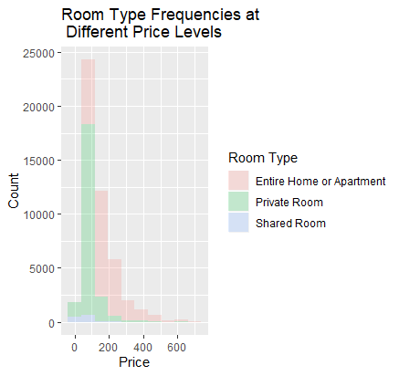
Exploratory Data Analysis (Frequency Plot)
Explored the relationship between the frequency of room type and varying price levels. This may be helpful in distinguishing what types of listings tend to be priced higher
The “entire home” or “apartment” is the most common type of room.
Shared rooms are the rarest type of room and they are thus removed
Notes:
Fred

Slide 6
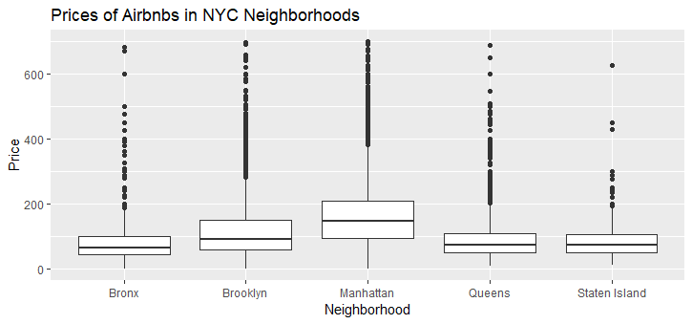
Exploratory Data Analysis (Boxplot)
Displays the prices of Airbnbs broken down by neighborhood
From this plot, it can be seen that Manhattan has the largest average price for Airbnb. Bronx, Queens, and Staten Island seem to have similar average prices
Notes:
Athira

Slide 7
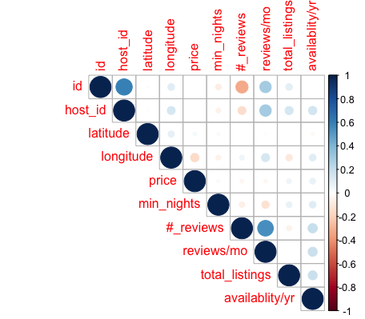
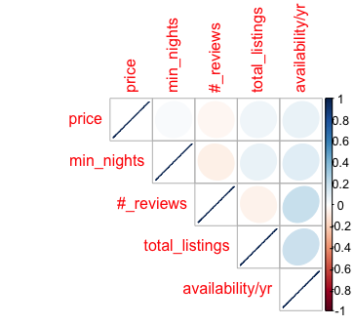
Exploratory Data Analysis (Correlogram)
Most of the variables have a low correlation with one another, however number_of_reviews and reviews_per_month have a relatively high correlation with each other. Variables with a significant correlation were removed as shown in the second plot.
Before Cleansing After Cleansing
Notes:
Athira

Slide 8
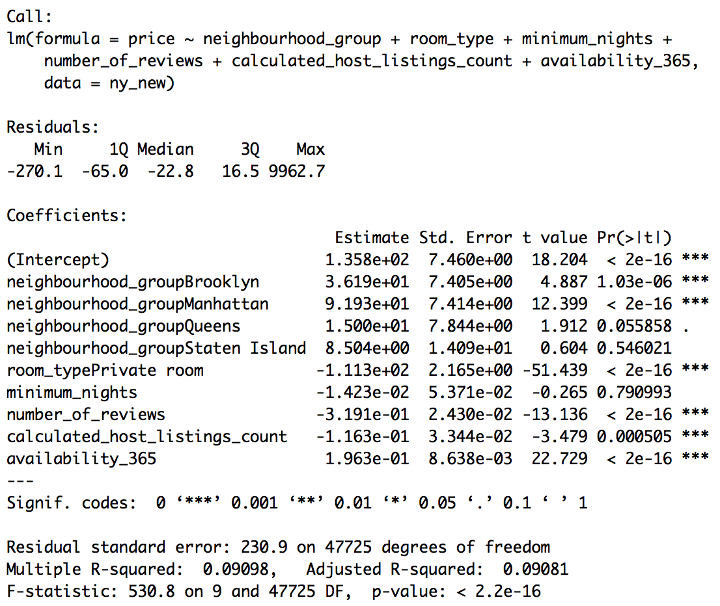
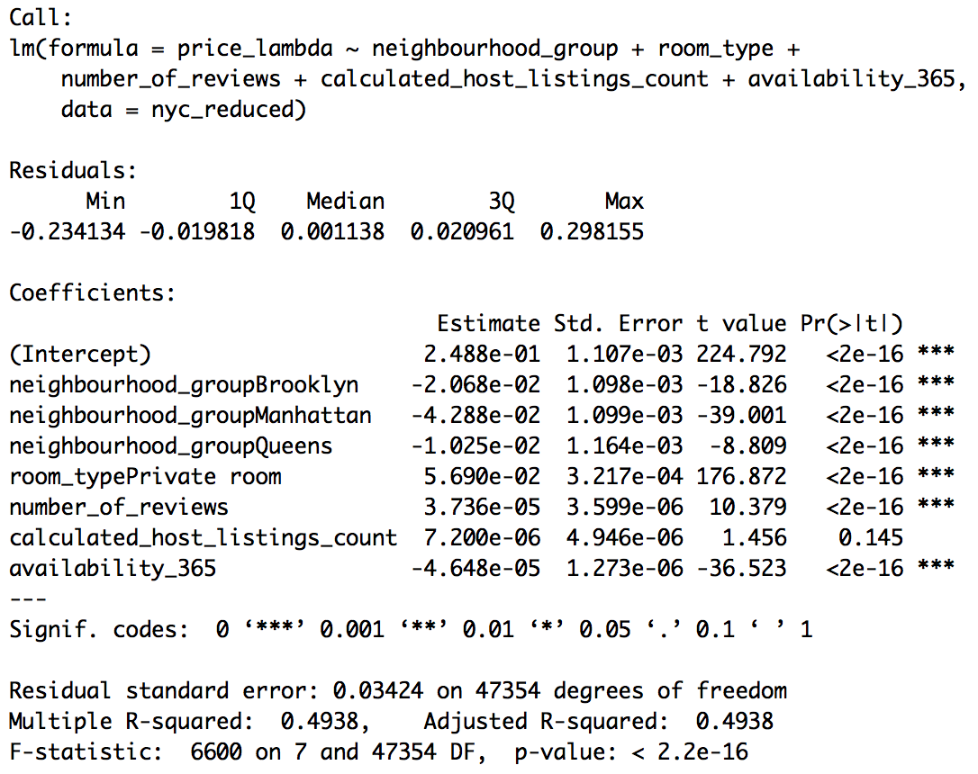
Two Regression Model Comparison
The first model had a very low value for R-squared 0.09. With the second model, it gets an R-squared value of .49. The second model explains the variance in the data much better than the first.

Slide 9
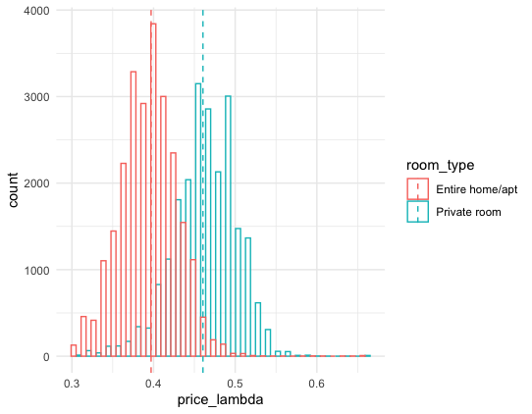
Key Transformations for Improvement
Dropped rows with neighborhood_group = Staten island (sample size too small) and the column of minimum_nights since its p-value is too large.
Transformed our response variable, price, with exponent lambda using the box cox transformation. New model would become lm(price to the power of lambda ~ all of the predictors)

Slide 10

Insights Gained
The variable price is extremely skewed with many high outliers. This is why our original model had a horrible fit. In order to create a good model to predict price, likely have to consider methods with greater flexibility.
Hypothesized that the minimum nights stayed at the Airbnb would be a significant independent variable in the first place because I assumed the longer the stay, the cheaper the price would be. However, it turned out that the minimum_nights has a large p-value of 0.79 and is statistically insignificant.

Slide 11

Future work
Incorporate quantitative variable size of the room
Identify whether a given listing is a superhost or not
Adding the average review rating of a listing into the model

